Slide 1
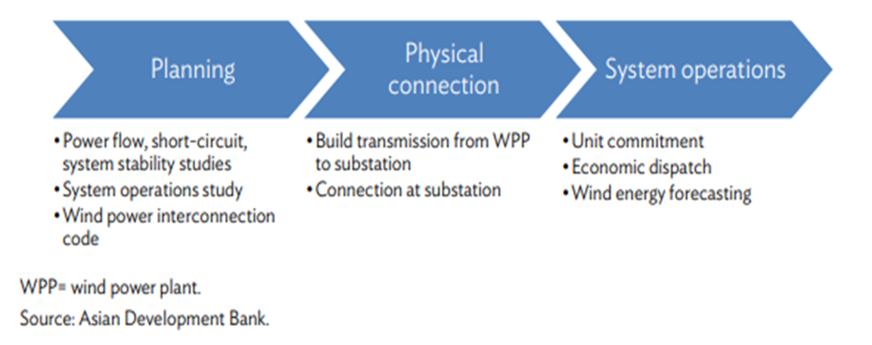
Power control and management systems for grid integration

Slide 2
Power control and management systems for grid integration
Grid integration of wind energy is simply a collection of all activities related to connecting WPPs to the grid.
Activities are split into three categories based on when the activities occur.
Planning includes activities that occur before a WPP is integrated.
Physical connection encompasses activities that occur during the physical connection of the wind farm to the grid.
System operations are the activities that occur after the WPP is connected to the grid

Slide 3
Planning
There are two distinct types of planning activities related to grid integration
Network-wide activities
Project-specific planning activities
The methodologies for both types of studies are the same, except for input data related to wind power installations.
In a network-wide study, the input is wind energy targets by region
While for a project-specific study, the input is WPP of the project.

Slide 4
1. Network-wide activities
Involves the overall strategy for integrating wind power into the existing grid
Assessing the current grid capacity, identifying potential bottlenecks, and planning upgrades to accommodate the additional power from wind farms
Grid code development, network-wide system integration studies with scenarios for different wind penetration levels, and system operations studies
Involves coordinating with other renewable energy sources and ensuring compliance with regulatory standards

Slide 5
2.Project-specific planning activities
System impact studies done for a specific wind project
Site-specific resource assessment (wind speed, direction, seasonal variations).
Power output estimation based on turbine capacity and efficiency
Selection of grid connection points, voltage levels, and transformer requirements
Assessment of environmental and land-use constraints for interconnection infrastructure
Includes selecting suitable sites, conducting feasibility studies, and designing the layout of the wind farm.
Factors such as wind resource assessment, environmental impact, and proximity to the grid are considered.
The goal is to maximize energy production while minimizing costs and environmental impact

Slide 6
Physical Connection
Design and implementation of infrastructure from the wind turbines to the grid substation
Design varies based on site conditions (terrain, distance, and existing infrastructure), grid requirements, and regulatory guidelines.
Physically, a WPP is connected to an existing high voltage transmission line in a substation.
In order to avoid the expense of building a substation, most WPPs choose to connect to an existing substation.
In the substation, the WPP line is connected to the medium voltage busbar, which is connected to a transformer to step up the voltage to the high voltage transmission line.
The medium voltage line from the WPP to the substation is built by the WPP.
The detailed design of the interconnection depends on the conditions on the ground.

Slide 7
Physical Connection
A. Wind Power Collection System
Wind turbines generate electricity at low voltage (690V - 1kV).
Multiple turbines are connected via medium-voltage (33kV - 66kV) collector lines.
Power from all turbines is routed to a main collection point or substation.
B. Step-Up Transformation
Step-up transformers increase voltage to transmission level (110kV - 400kV) for efficient long-distance transmission.
Located at the wind farm or a dedicated substation near the WPP.
C. Transmission to Grid Substation
A high-voltage transmission line (HVAC or HVDC) carries power to the main grid.
HVDC transmission is preferred for offshore wind farms due to lower losses over long distances.
Designed to minimize power losses, voltage drops, and reactive power issues.

Slide 8
Physical Connection
D. Grid Interconnection Substation
Connects the wind power plant to the main transmission or distribution network.
Includes circuit breakers, protection relays, SCADA systems, and reactive power compensation units (STATCOM, SVC).
Must comply with grid interconnection standards, ensuring power quality, stability, and fault handling capability.
E. Impact of Site Conditions on Design
Onshore WPPs: Terrain, land-use restrictions, accessibility influence layout and interconnection design.
Offshore WPPs: Subsea cables, offshore substations, and weatherproofing are key considerations.

Slide 9
System Operation
After the WPP is physically connected to the transmission line, the attention of grid integration turns to system operations, which integrate the production of WPPs into the grid operations.
The goal of grid operations is to commit and dispatch all generation units in the system with the objective of meeting demand in a reliable and economical manner.
Wind energy forecasting is an important enabler in order to meet these objectives, given the variability and uncertainty of wind resources.
Day-ahead hourly wind energy forecasts are used in the unit commitment process and intraday updates to forecasts are used in the economic dispatch process.

Slide 10
1. Unit Commitment Process
This involves determining which generating units should be online at any given time to meet the expected demand.
The goal is to minimize operational costs while ensuring reliability.
This process takes into account factors such as fuel costs, maintenance schedules, and grid constraints.
Advanced algorithms and optimization techniques are used to solve the unit commitment problem

Slide 11
2. Economic Dispatch Process
Real-time power allocation to minimize generation costs while maintaining grid reliability.
Wind power is dispatched based on available wind resources, grid demand, and market prices.
It involves determining the optimal output of each generating unit to meet the current demand at the lowest cost.
The economic dispatch process considers factors such as fuel prices, generator efficiency, and transmission constraints.
Uses advanced forecasting techniques (AI, machine learning) to optimize dispatch.

